Slide 1
C++ Programming Today 2nd Edition By Barbara Johnston Chapter 5
Instructor: <Instructor Name>
Lecture Slides by Kelly Montoya and Rob Garner

Slide 2
Overview
Data Variables and Memory
Pointers
Returning multiple values from functions
References
Why Pointers are Important
Queue Class
Common Errors With Pointers and References
File IO

Slide 3
Common Errors With Pointers and References
Describe common errors with pointers and references.

Slide 4
Common Errors With Pointers and References
Compiler Error: cannot convert parameter 1
from 'int' to 'int *
Prototype:
Function:
void AskForXandY(int *pX, int *pY);
void AskForXandY(int *pX, int *pY)
{
cout << "\n enter x and y ";
cin >> *pX >> *pY;
}

Slide 5
Common Errors With Pointers and References
The call statement is written incorrectly as:
We are passing integer values in the call statement to a function whose input values are pointers.
AskForXandY(x,y);
Need &x and &y
Always check the prototype/function header line with the call statement.

Slide 6
Common Errors With Pointers and References
Compiler Error: cannot convert parameter 1
from 'int *' to 'int &'
Prototype:
Function:
void AskForXandY(int &rX, int &rY);
void AskForXandY(int &rX, int &rY)
{
cout << "\n enter x and y ";
cin >> rX >> rY;
}

Slide 7
Common Errors With Pointers and References
The call statement is written incorrectly as:
By placing the &x, &y in the call statement, we are passing integer pointers to the function.
The function’s input values are references; therefore, the message indicating cannot convert int* to int & shows the confusion.
AskForXandY(&x,&y);
DON’T need the &x and &y
Once again, check that your call statements match the input list!

Slide 8
Common Errors With Pointers and References
Compiler Error: illegal indirection
Here is the line of code in the pointer version of the AskForXandY function:
Check the prototype. We intend to use pointers. It looks good.
The function call in main looks good too:
cin >> *pX >> *pY;
void AskForXandY(int *pX, int *pY);
AskForXandY(&x, &y);

Slide 9
Common Errors With Pointers and References
Function:
The input list to this function shows two integers, NOT two integer pointers.
void AskForXandY(int pX, int pY)
{
cout << "\n enter x and y ";
cin >> *pX >> *pY;
}
If you forget to place the * in the function header line (sometimes due
to copy/paste errors), you’ll encounter the “illegal indirection” message.

Slide 10
Properties associated with variables:

Slide 11
Properties associated with variables:
A pointer and a reference is designed to hold a hexadecimal address.
A pointer is declared using the * operator, a reference is declared using an &.
During a call by reference using pointers, a variable’s address is assigned explicitly into the pointer by use of the address operator, &.
During a call by reference using references, a variable’s name is used in the call statement, but its address is passed to the function.

Slide 12
Properties associated with variables:
A pointer, when paired with the indirection operator, accesses the data located at the address that it contains.
Comparing pointers and references:
Notes:
Program 5-9 uses pointers and references.

Slide 13
The ifstream and ofstream Classes
The class ifstream contains the necessary functions for opening and reading data from files.
The class ofstream contains the functions for writing data to a file.
Because they are stream classes, many of they things we do when using cout or cin apply directly to our ifstream and ofstream objects.
See http://www.cplusplus.com/reference/fstream/
Notes:
Program 6-14 revisits the phone bills program using ifstream and ofstream objects, also broken up into 3 files.

Slide 14
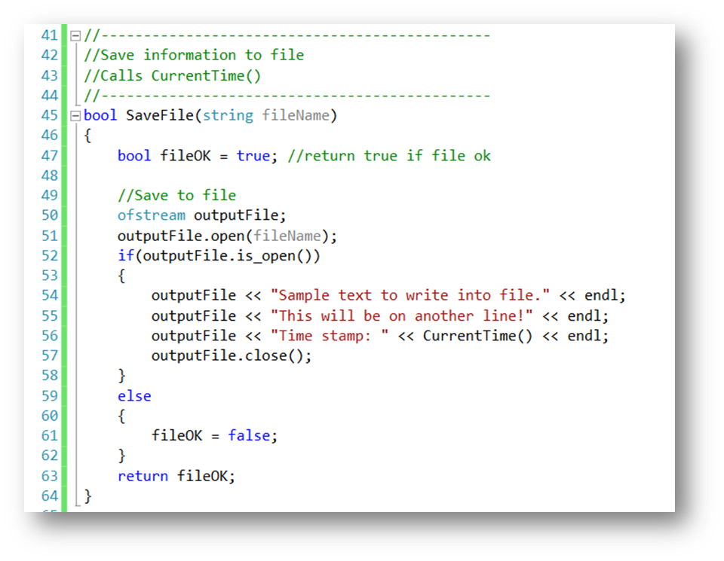
Writing to a File

Slide 15
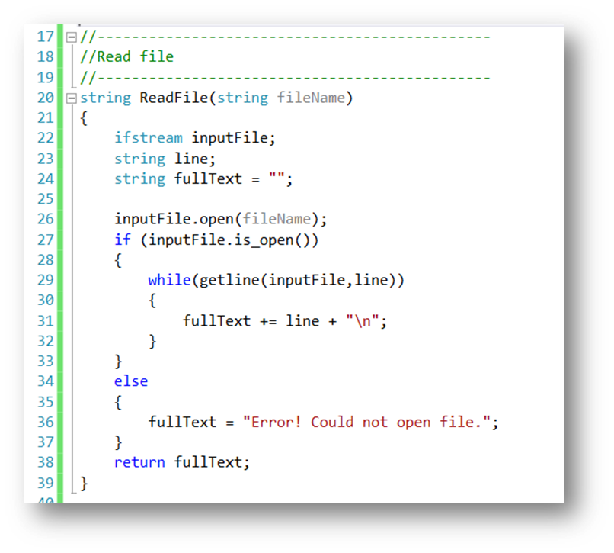
Reading from a File

Slide 16
FileIO Demo
Demonstrate how to use file IO.

Slide 17
Summary
Data Variables and Memory
Pointers
Returning multiple values from functions
References
Why Pointers are Important
Queue Class
Common Errors With Pointers and References
File IO

